Slide 1
Office 365 Development

Slide 2
Course Agenda
Office 365 Development
Module 1: Overview of Office 365 Development
Module 2: Getting started with Apps for SharePoint
Module 3: Getting started with Apps for Office
Module 4: Getting started with the Office 365 APIs
Module 5: Getting started with Mobile Development with Office 365
Module 6: Moving Full Trust Code to the cloud using repeatable patterns and best practices
Module 7: Setting up your Developer environment in Office 365
Module 8: Setting up your on-premises environment for app development

Slide 3
Setting up your Developer Environment in Office 365

Slide 4

Agenda
Overview
The Office 365 Environment
The Windows Azure Environment
Seller Dashboard

Slide 5
Developer vision
USERS
DATA
HTML

Slide 6
Overview

Slide 7
Office 365 Environment
Office client
Exchange Online
SharePoint Online
OneDrive for Business
Azure Active Directory (AAD)
Notes:
SharePoint Online provides a solid business collaboration platform on which developers can build solutions quickly by using familiar development tools. In addition to in-browser customizations, SharePoint Online supports development with Microsoft SharePoint Designer 2010, Microsoft Visual Studio 2010, and Microsoft Visual Studio Team Foundation Server 2010. SharePoint Online enables you to modify sites directly and deploy code as sandboxed solutions that are run in a protected environment to safeguard the environment from poorly performing or malicious code.
SharePoint Online opens a new arena for developers to create solutions for customers who use the Office 365 service instead of maintaining on-premises servers, or for clients who want to take advantage of hybrid deployments where some data is stored behind the firewall and other data is off-loaded in the cloud.

Slide 8
Azure Active Directory
Identity and Access Management for the cloud
Can create new directories or manage existing ones in Azure subscription
Used by Office 365 for authentication
Used by Azure for user authentication and application authorization
Notes:
Azure Active Directory is a comprehensive identity and access management cloud solution. It combines core directory services, advanced identity governance, security, and application access management. Azure AD also offers developers an identity management platform to deliver access control to their applications, based on centralized policy and rules.

Slide 9
Office 365 Development Options
 | SharePoint add-ins | Office add-ins | Microsoft Graph
Word Excel |  | Task Pane add-in Content add-in | Excel
Outlook |  | Mail add-in | Mail Calendar Contacts Groups
SharePoint | SharePoint-Hosted add-in Cloud-Hosted add-in |  | Files Sites
OneDrive for Business |  |  | Files
Video Portal |  |  | Video
Skype |  |  | Skype
OneNote |  |  | Notes
Planner |  |  | Tasks
Azure AD |  |  | Users & Groups

Slide 10
Windows Azure Environment
Azure Active Directory (AAD)
Azure Access Control Services (ACS)
Azure Web Sites

Slide 11
Azure Access Control Services
Identity and Access Management for the cloud
More generic than Azure Active Directory
Can create new namespaces in Azure subscription
Used by Office 365 for application authorization
Notes:
Windows Azure Access Control Service (ACS) is a Windows cloud-based service that provides an easy way of authenticating and authorizing users to gain access to web applications and services while allowing the features of authentication and authorization to be factored out of the application code. This facilitates application development while at the same time providing users the benefit of being able to log into multiple applications with a reduced number of authentications, and in some cases only one authentication.

Slide 12
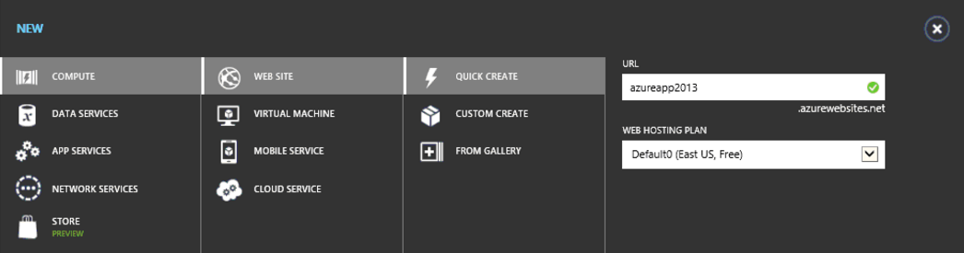
Azure Web Sites

Slide 13
Office 365 and Azure
Office 365 users can be managed in Azure
Office 365 users can be Azure administrators

Slide 14
Hosting Options
 | Web Site | Office 365 Site | Windows 10
SharePoint add-ins | Provider-Hosted add-in | SharePoint-Hosted add-in
Office add-ins | Task Pane add-in Content add-in Mail add-in
Microsoft Graph | Web Application |  | Windows 10 App

Slide 15
SharePoint add-ins Dev Environment
Office 365 Developer Site Collection
Windows Azure Subscription
Visual Studio 2013/5
Office Developer Tools for Visual Studio 2013/5

Slide 16
Office add-insDev Environment
Office 365 Office and Exchange
Windows Azure Subscription
Visual Studio 2013/5
Office Developer Tools for Visual Studio 2013/5

Slide 17
Microsfot Graph Dev Environment
Office 365 Office and Exchange
Windows Azure Subscription (or other infrastructure)
Windows 10
Visual Studio 2013/5
Microsoft Graph SDK

Slide 18
Setting up Environments
Sign up for an Office 365 subscription
Create a Developer Site Collection
Sign up for Windows Azure subscription
Link Office 365 AAD to Windows Azure
Make Office 365 user administrator in Windows Azure
Use Visual Studio remotely to develop

Slide 19
The Office 365 Environment

Slide 20
Office Dev Center
Content
Samples
Documentation
Sign up for Office 365 Dev Program
Notes:
Find how-to content, sample code, SDK and API documentation, VBA references, training, and articles for developing solutions and customizing Office applications and SharePoint products and technologies, including client applications, services, tools, and technologies such as apps for Office, apps for SharePoint, Access, Excel, Exchange, Lync, SharePoint Server, SharePoint Foundation, Skype, and Word.
Use an Office 365 Developer Site as a development and testing environment to shorten your setup time and start creating, testing, and deploying your apps for Office and SharePoint. Deploy the "Napa" Office 365 Development Tools to this preconfigured SharePoint site and you also get a head start on developing SharePoint-hosted apps, and apps for Office documents and mail items, without installing Visual Studio 2012 and Office Developer Tools for Visual Studio 2013 on your development computer. With an Office 365 Developer Site, you get an isolated app domain for SharePoint-hosted apps, preconfigured to use OAuth, so that you can use the Microsoft Azure Access Control Service (ACS) for authenticating and authorizing provider-hosted apps for SharePoint that are deployed to this site.

Slide 21
Developer Site Collection
Required for remote add-in development
Created automatically if you sign up for an Office 365 Developer Site
Use the Developer Site template to create a new Site Collection in an existing tenancy
Notes:
An Office 365 Developer Site makes it easier to get set up and start creating, testing, and deploying your apps for Office and SharePoint more quickly. Office 365 enterprise (E3 or E4) subscriptions include a site template you can use to create a Developer Site.

Slide 22
App Catalog
Required to publish add-ins
Create in the SharePoint Admin Center
Apps/App Catalog
Notes:
As a SharePoint Online admin, you can create an App Catalog site to make internally developed custom apps available for users to install when they browse apps under the From Your Organization filter on the Site Contents page. Site owners can then add these apps to customize sites with specific functionality or to display information.
After an App Catalog site has been created, you can use it to upload any custom apps that your organization has developed. Uploading custom apps is not much more complicated than uploading a document to a library and setting some properties. You can also use the App Catalog site to do things like install custom or third-party apps on sites for users (also called app deployment). You can also manage app requests from users.

Slide 23
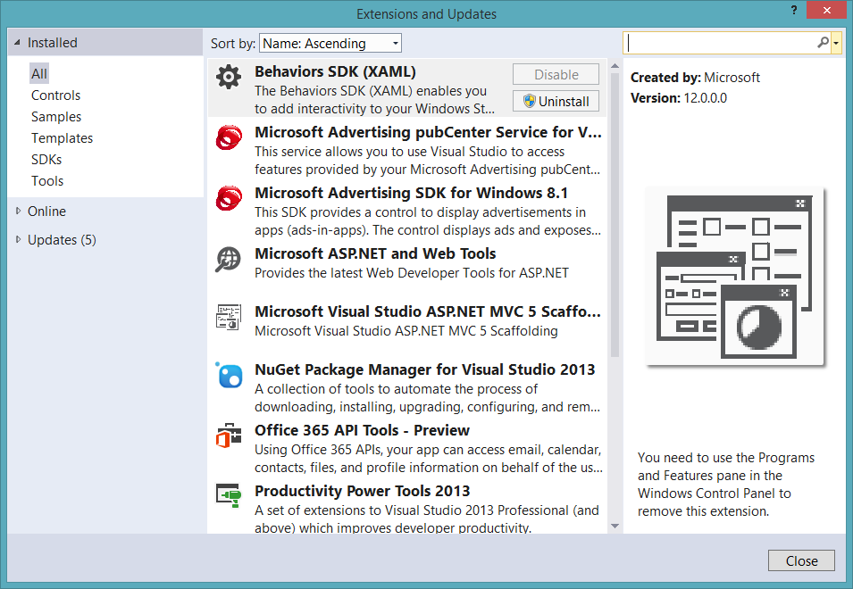
Visual Studio 2013
90-Day Trial
http://www.visualstudio.com/en-us/downloads/download-visual-studio-vs.aspx
Office 365 API Tools

Slide 24
Visual Studio 2015
90-Day Trial
http://www.visualstudio.com/en-us/downloads/download-visual-studio-vs.aspx
Office 365 Tools
Check box on installation
OR repair Visual Studio in Windows and select “Office tools box

Slide 25
demo
Obtaining an Office 365 Developer Subscription

Slide 26
The Windows Azure Environment

Slide 27
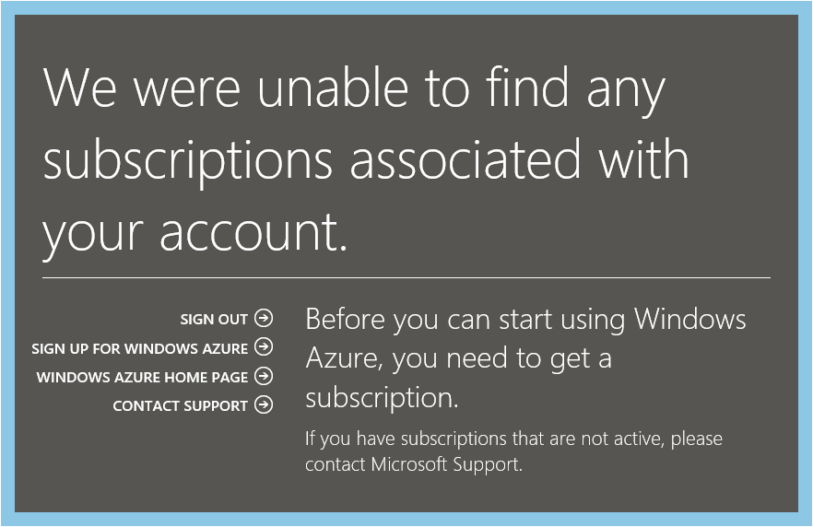
Azure Subscription
Navigate to Azure Portal using Office 365 credentials
When prompted, sign up for a trial

Slide 28
Link Office 365 and Azure
Log into Microsoft Azure subscription as administrator
Click on the Active Directory link.
Click New>Active Directory>Directory>Custom Create
Select to Add an Existing Directory
Follow the steps to add an existing directory
Notes:
It’s not required to link the Office 365 Directory to an Azure subscription
for simply creating provider-hosted apps, but it makes life a bit easier
and opens up the ability to call into Office 365 from other applications.

Slide 29
Office 365 Account as Azure Admin
Log into an existing Microsoft Azure as administrator
Click the Settings link
Click Administrators
Click Add
Add the Organizational Account from Office 365
Notes:
By adding an Office 365 account as an Azure administrator,
you can use a single account for managing both subscriptions

Slide 30
demo
Obtaining a Windows Azure trial Subscription

Slide 31
Seller Dashboard

Slide 32
Overview
Required to submit add-ins to Microsoft marketplaces
SharePoint add-ins
Office add-ins
Windows 10
Azure Marketplace
May be company or individual
Notes:
If you are a software developer who creates apps that support or enhance Microsoft technologies, such as Microsoft SharePoint, Microsoft Office, and Azure, you can use the Seller Dashboard to submit and distribute your apps to Microsoft marketplaces.

Slide 33
Sign Up Process
Obtain a Microsoft account, if you do not have one
Sign into the Seller Dashboard with your Microsoft Account
http://go.microsoft.com/fwlink/?LinkId=248605
Fill in the registration information
Submit for approval

Slide 34
Publishing Process
Build the add-in
Upload app to your Seller Dashboard account
Submit add-in for approval
See add-in in the Office Store
Track add-in usage and receive payout

Slide 35
Office Store course!
6 hours of training on Office Store
Overview of the Office App Store
Getting Your App Submitted & Approved: Best Practices
How Store Apps Are Different
Embedding Marketing in Your Code
Demo Fest of Some Leading Store Apps

Slide 36
Wrap Up

Slide 37
Summary
The Office 365 Environment
The Windows Azure Environment
Seller Dashboard
Notes:
What new APIs are available, in preview, in the Office 365 Platform
How to use these API’s in your platform of choice
Some sample business scenarios for leveraging these API’s
Level: Intermediate
Audience: Developer Essentials

Slide 38
Developer Program Launch
1 YEAR FREE
E-mail Newsletters
Free Developer Subscription
Free Training
Free Tools
Webinars
http://dev.office.com/devprogram

Slide 39


Engage
Office 365 Network
https://www.yammer.com/itpronetwork
Twitter
S
S
t
t
a
a
r
r
t
t
@OfficeDev
Stack overflow
[ms-office]
Channel 9 Dev Show
http://aka.ms/O365DevShow
Podcasts http://dev.office.com/podcasts
Snack Demos
http://aka.ms/o365DevSnackDemos
UserVoice
http://officespdev.uservoice.com/

